Slide 1
Big Mountain Resort Price Analysis
Syed Hussain Ather

Slide 2
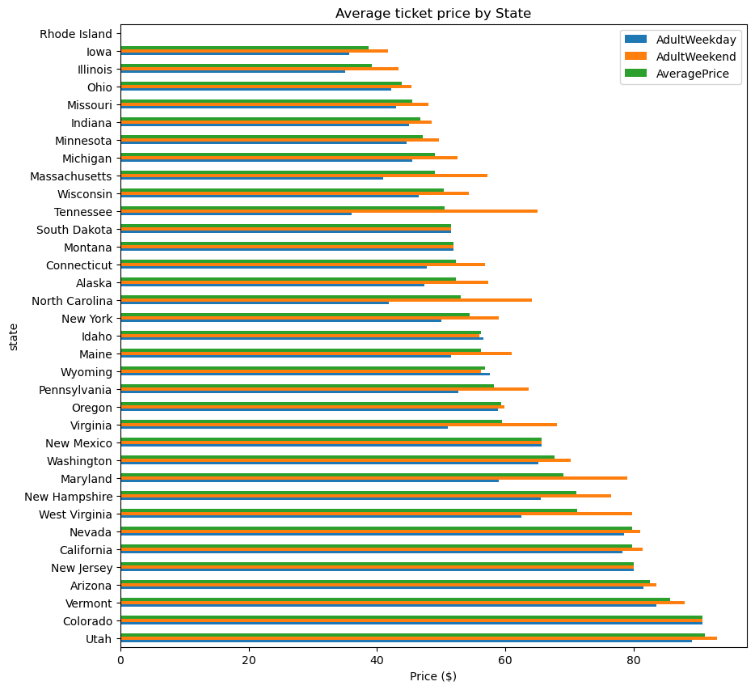
​​Problem identification - Addressing Big Mountain Resort's Pricing Strategy
Big Mountain Resort faces a critical challenge in reevaluating its pricing strategy due to recent increases in operating costs.
The objective is to develop a data-driven pricing model that accurately reflects the value of Big Mountain Resort's facilities and services in the competitive ski resort market.

Slide 3
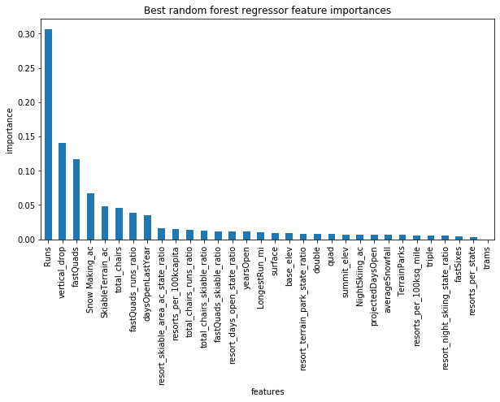
​​Problem identification - Analyzing Market Dynamics and Competitor Pricing
Market analysis reveals the importance of understanding competitor pricing strategies and market dynamics to inform pricing decisions.
The goal is to align Big Mountain Resort's pricing with industry benchmarks and customer expectations to remain competitive.

Slide 4
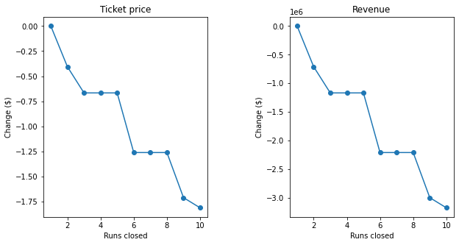
Recommendations and Key Findings - Pricing Recommendations and Key Insights
Based on the analysis, it is recommended to increase ticket prices by at least $10 to better reflect the value of Big Mountain Resort's offerings.
Key findings include opportunities for revenue optimization through strategic run management and leveraging ancillary revenue streams.

Slide 5
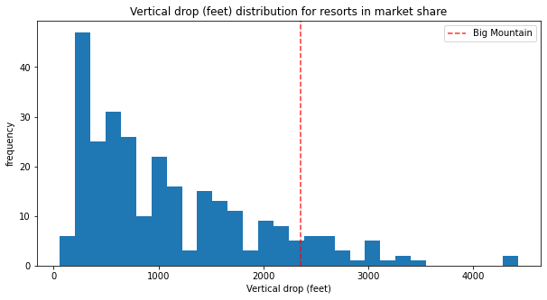
Modeling Results and Analysis - Exploring Resort Features and Pricing Trends
The modeling approach involved analyzing resort features and their impact on ticket prices using machine learning techniques.
Insights from Random Forest Regression and Principal Component Analysis reveal significant correlations between resort features and pricing trends.

Slide 6
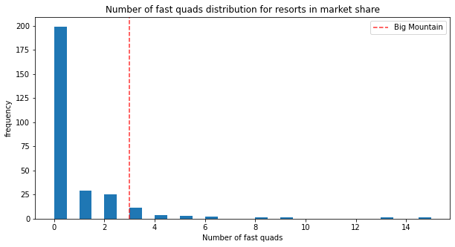
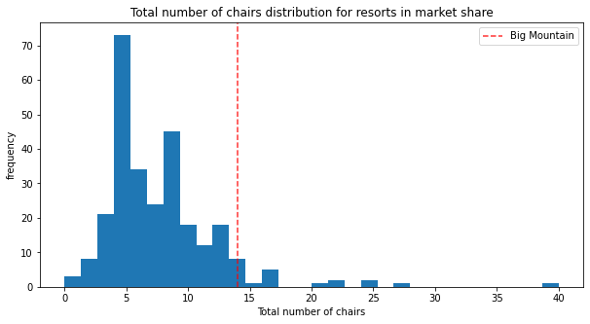
Modeling Results and Analysis - Exploring Resort Features and Pricing Trends

Slide 7
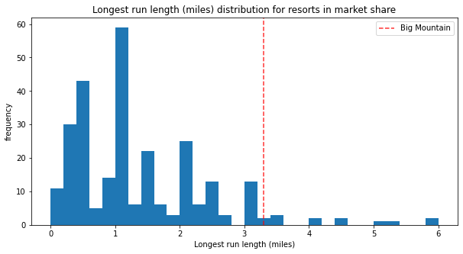
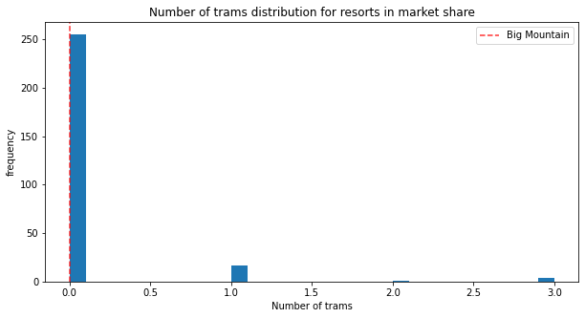
Modeling Results and Analysis - Exploring Resort Features and Pricing Trends

Slide 8
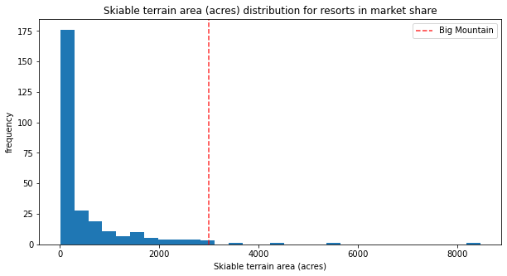
Modeling Results and Analysis - Exploring Resort Features and Pricing Trends

Slide 9
Modeling Results and Analysis (continued) - Understanding Big Mountain Resort's Competitive Position
Evaluation of Big Mountain Resort's competitive position relative to other resorts highlights areas of strength and opportunities for improvement in pricing strategy.
Comparison of key resort features and pricing strategies informs strategic pricing decisions.

Slide 10
Modeling Results and Analysis (continued) - Refining Pricing Strategy and Revenue Optimization
Refinement of pricing strategy based on model insights enables optimization of revenue through strategic pricing and run management.
Future enhancements and areas for further analysis include incorporating data on ancillary revenue streams and exploring pricing strategies employed by other resorts.

Slide 11
Summary and Conclusion - Summary and Future Outlook
By implementing the recommended price increase and optimizing revenue through strategic run management, Big Mountain Resort can enhance its competitiveness and profitability in the ski resort market.
Conclusion highlights the potential for future growth and development, with a focus on continuous improvement and adaptation to market dynamics to ensure Big Mountain Resort's long-term success.

